Slide 1
Azure Cosmos DB
By
MIRUNA Sureshkumar J

Slide 2
Cosmos DB
Cosmos DB is a multi-model NoSql database. Currently it can handle three types of non-relational data:
Document databases
Graph databases
Key-value databases
Cosmos DB enables you to elastically and independently scale throughput and storage
Fast, single-digit-millisecond data access using your favorite API including SQL, MongoDB, Cassandra, Tables

Slide 3
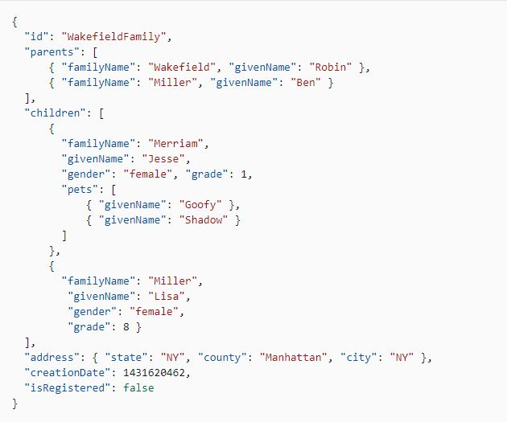
Data

Slide 4
API for SQL Querying
Query for selecting record where id is “WakedfieldFamily”
SELECT * FROM Families f WHERE f.id = "WakefieldFamily“
Query returns all the children in the family
SELECT c.givenName FROM Families f JOIN c IN f.children WHERE f.id = 'WakefieldFamily‘

Slide 5
API for MongoDB Querying
Query for selecting record where id is “WakedfieldFamily”
db.families.find({ id: "WakefieldFamily"})
Query returns all the children in the family
db.families.find( { id: "WakefieldFamily" }, { children: true } )
Query returns all the families that are registered
db.families.find( { "isRegistered" : true })

Slide 6
Python API
Library uses azure.cosmos
Create client with endpoint and key CosmosClient(endpoint , key)
Create Database client.create_database_if_not_exists(database_name)
Create Container database.create_container_if_not_exists(container_name)
Insert Data client.createItem(container , data)
Querying container.query_items(query)

Slide 7

Thank you!!

